Slide 1


Basic Legal Citation Presentation 2
Presented By
Devi Snigdha Muppala
Sania Nagpal

Slide 2
The Team
Aiswarya Jami aj493
Akshay Tata at758
Brenda Olivia Martis bom6
Devi Snigdha Muppala dm754
Harish SethuMadhavan hs643
Joao Curcio jfc293
Sania Nagpal sn579
Yihui Fu yf263
Notes:
Interrupted for team introduction

Slide 3
Outline
Purpose and Scope
Requirements
Project Progress
Design Alternatives
Proposed Solution

Slide 4
The client
Prof. Peter W. Martin
The Co-founder of Cornell's Legal Information Institute (LII)
The Jane M.G. Foster Professor of Law, Emeritus
Former dean of Cornell Law School
Notes:
Arms confirms if it’s first priority

Slide 5
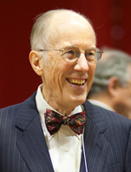
The client
Prof. Peter W. Martin
The Co-founder of Cornell's Legal Information Institute (LII)
The Jane M.G. Foster Professor of Law, Emeritus
Former dean of Cornell Law School
Notes:
Arms confirms if it’s first priority

Slide 6
Project Goal / Objective

Slide 7
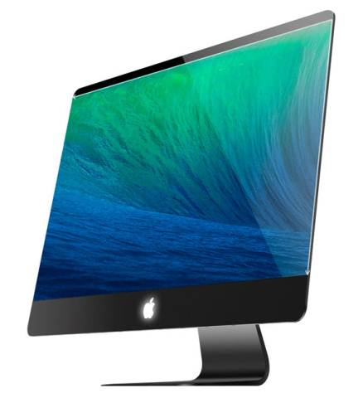
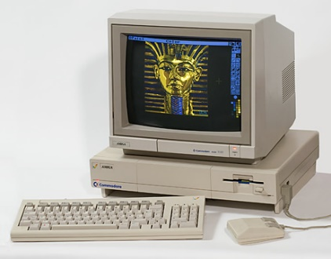
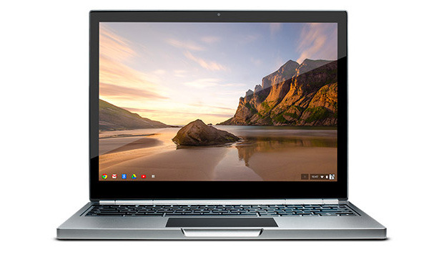

Modernize website
1993
2015
Notes:
Work in 1993. Website in 1994. […]

Slide 8
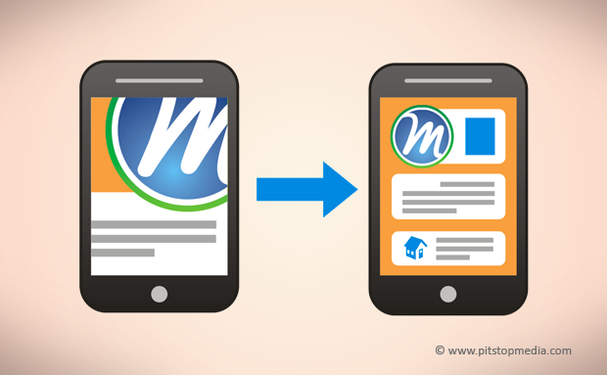
Mobile-friendly
Notes:
Arms confirms if it’s first priority

Slide 9
Easy conversion to all formats
HTML5
Original HTML
EPUB
PDF
MOBI

Slide 10
Current Website

Slide 11
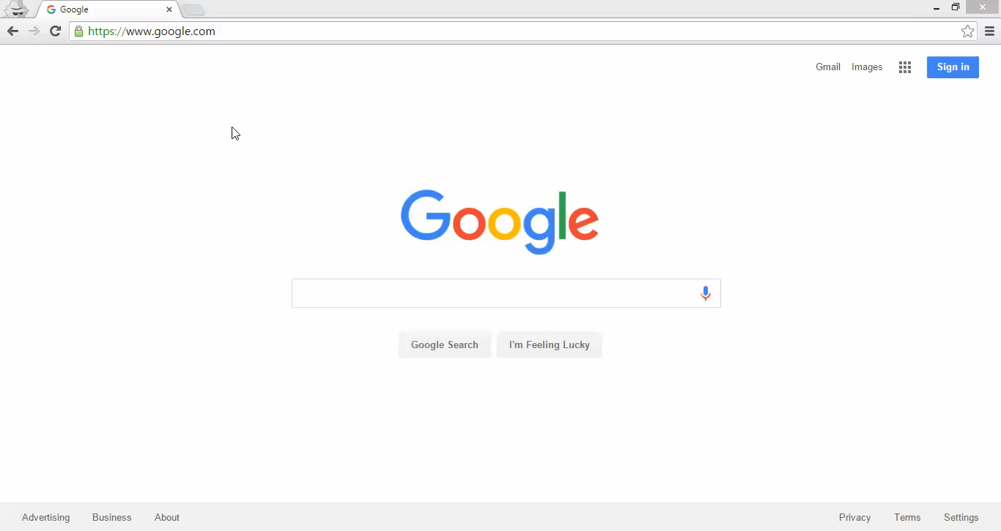

Slide 12
Progress

Slide 13
Tasks completed in Iteration I
Interactive, mobile friendly website
Conversion to PDF, ePub
Remove iFrames and add expand-collapse panels for examples.

Slide 14
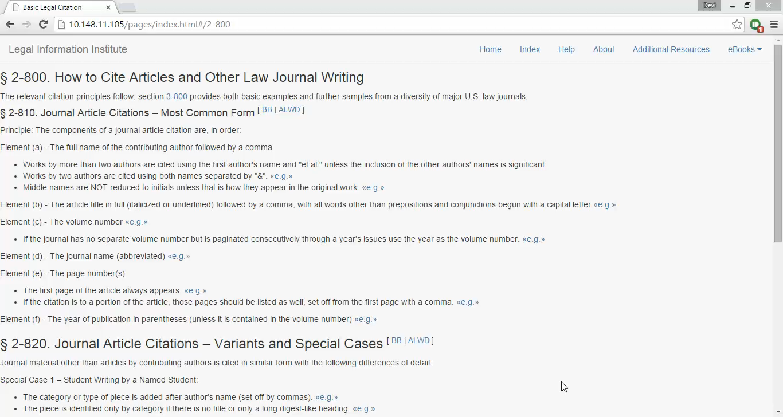

Slide 15
User Testing I
Pop-up menus rather than Expanding and collapsing the text.
<<e.g.>> should appear as a button
An initial text on the page for examples
Background colors in the pop-up for a stronger color.

Slide 16
User Testing I (cont.)
"Resources" should be "Additional Resources“
Inputs from Sylvia on markup tags. For example:
<state>
<alabama> -> <state name=“alabama”>
</alabama> </state>
</state>

Slide 17
Tasks completed in Iteration II
Expand-Collapse Panels replaced by Pop-ups.
HTML Markup tags added to some files.
Search implemented for the list of States table.

Slide 18
Tasks Pending
Handle opening of new tabs
Complete the HTML Markup tags
Format conversions (Partially done)
User Testing by the Law Students

Slide 19
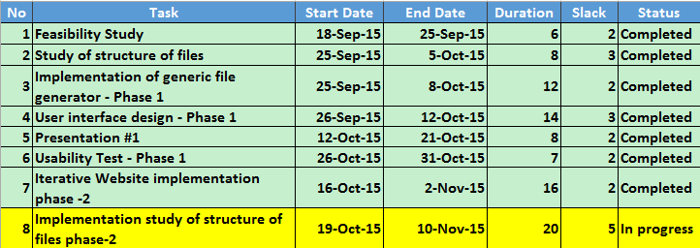
Gantt Chart

Slide 20
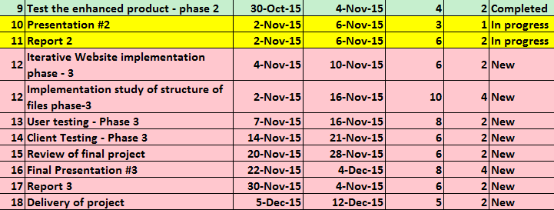
Gantt Chart (Contd.)

Slide 21
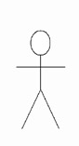


Workflow
Uses
Publish
HTML
Author
View/Download
Visitor

Slide 22
Demo of the new website
Notes:
Demo: jumping from windows. Go slowly:” I’m going to…”
Design: follow up with LII existing skin
Confirm with client about the menu hierachy
Martin: other navigation?

Slide 23
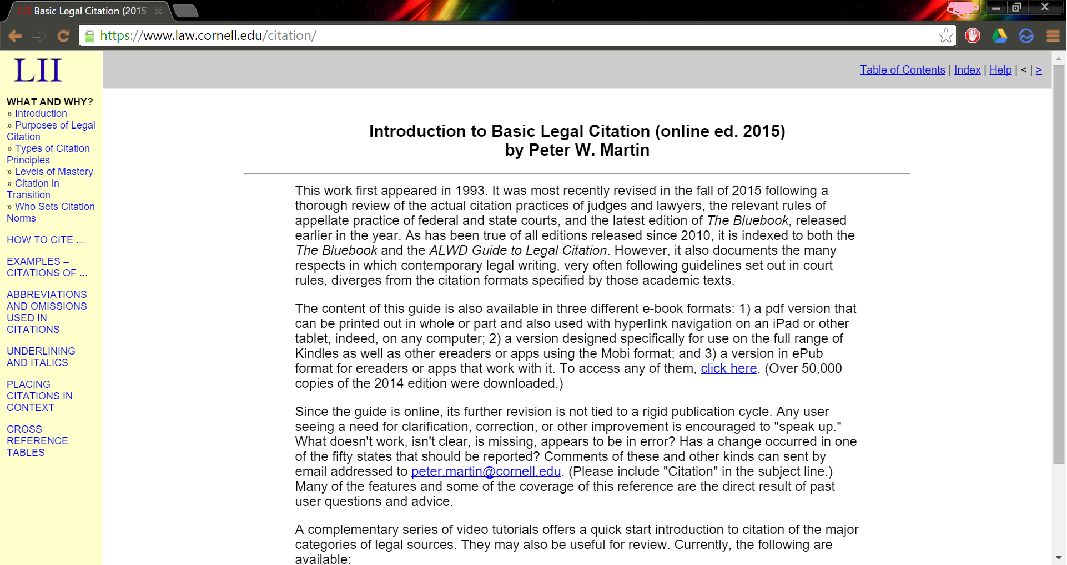
Website revamp

Slide 24
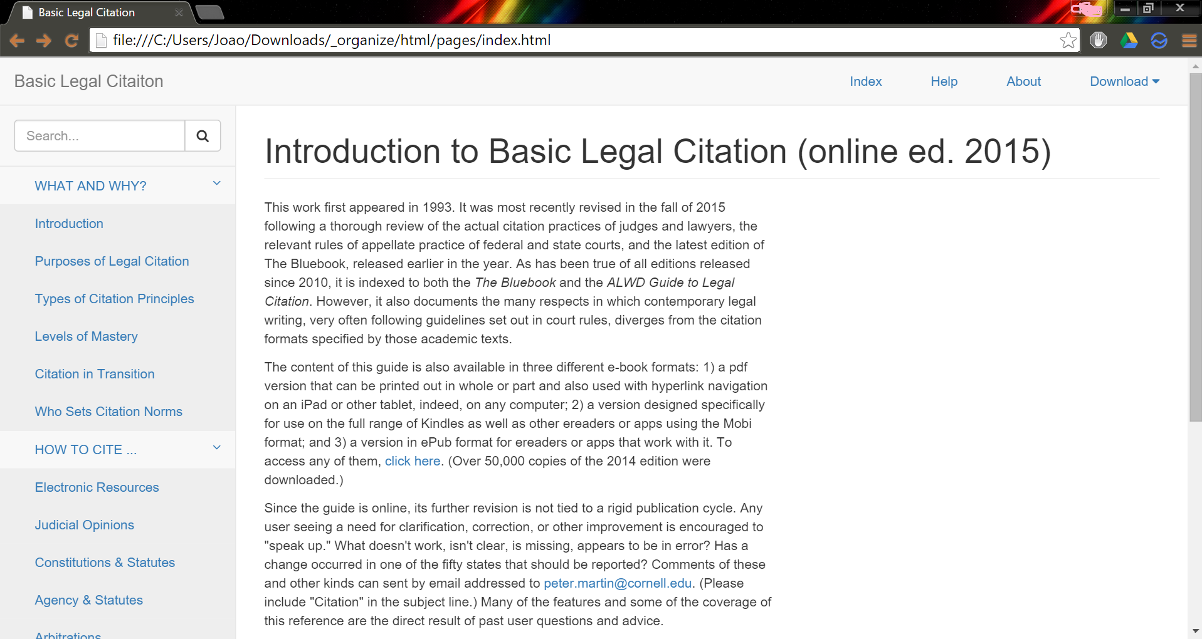
Website revamp

Slide 25

Website revamp

Slide 26
Key features of new prototype
Mobile friendly
Responsive and interactive
Dynamic with Search engine optimization
Search box

Slide 27
Q & A
Notes:
Peter:
Might still need tables in static ebooks
Sara:
Interactivty examples: user; author
Metadata search
Table replaced
Not guess, but client experience
Strong progess, capable to finish it
More communications
Slyvia:
More communications. There is something we’ve done that we know not working.
Arms:
Building on an existing system, getting the requirements right is more difficult. Which is the client really want.
A little bit worried about schedule. Time for user testing and making changes
Gantt chart: how to describe the work it’s done. Complete is not complete.
Difficult in userbility and format conversion.
Is converting exsiting html a part of a project. XHTML to HTML.

